Slide 1
Computational Fluid Dynamics (CFD)
DAY 2
First order derivatives →
forward, backward, and central difference methods
Kumaresh

Slide 2
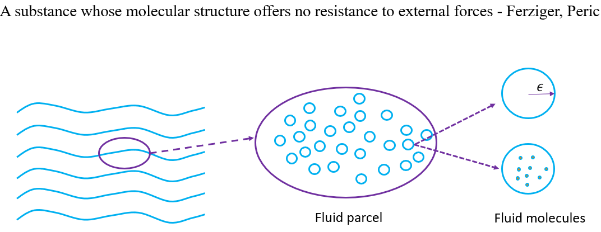
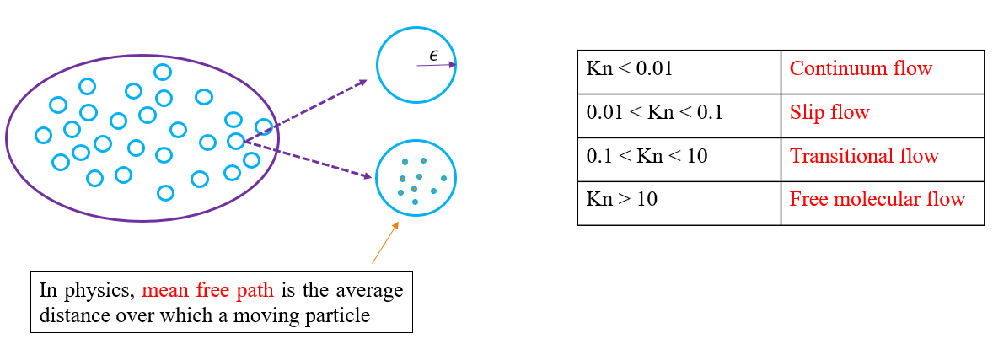
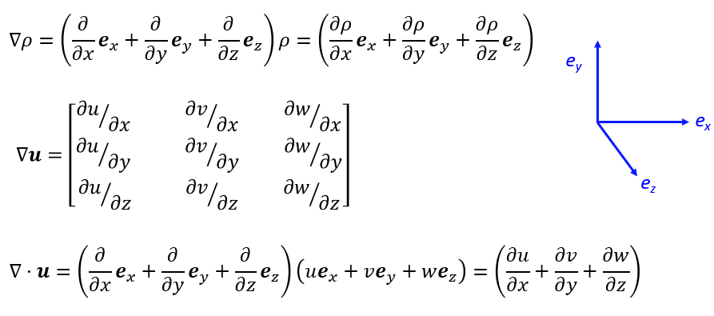
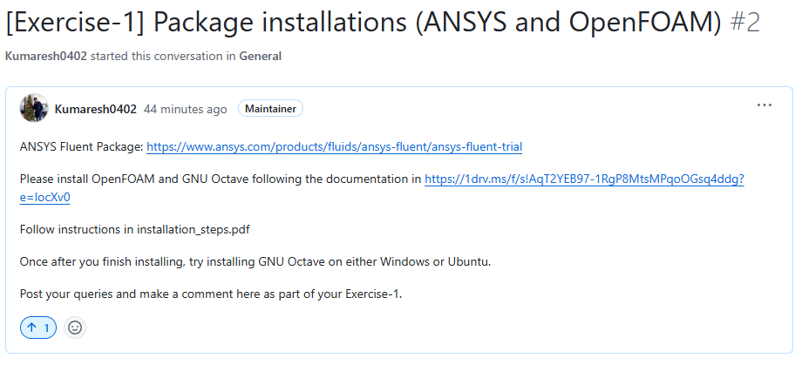
Quick Recap

Slide 3
Contents
Mathematical operations
Taylor series expansion and FDM
Analytical and Numerical solutions
Exercise – 2

Slide 4
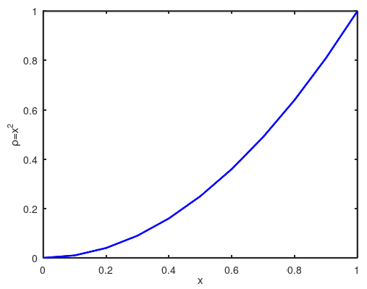
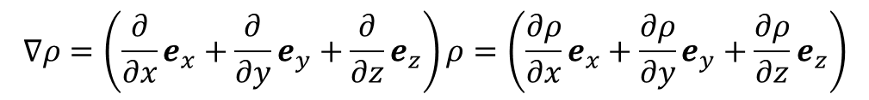
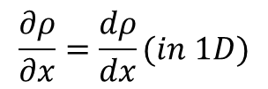
Mathematical operations
Gradient
e_{y}
e_{x}
e_{z}

Slide 5
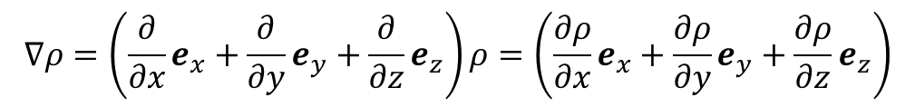
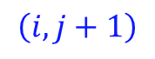
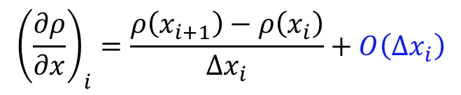
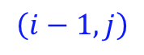
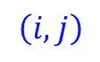
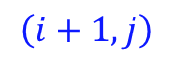
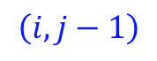
Finite Difference Method (FDM)

Slide 6

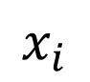
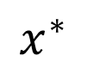
Taylor series expansion
$$ρ\left(x^{∗}\right)=ρ\left(x_{i}\right)+\left(x^{∗}−x_{i}\right){\left(\frac{dρ}{dx}\right)}_{i}+{\left(x^{∗}−x_{i}\right)}^{2}{\left(\frac{d^{2}ρ}{dx^{2}}\right)}_{i}+{\left(x^{∗}−x_{i}\right)}^{3}{\left(\frac{d^{3}ρ}{dx^{3}}\right)}_{i}+…$$

Slide 7
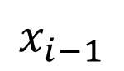
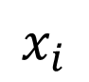
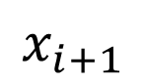
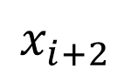
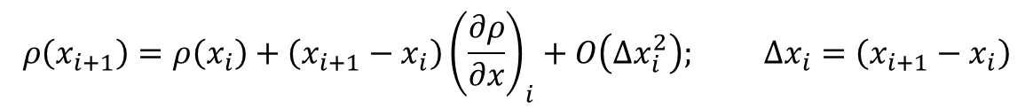
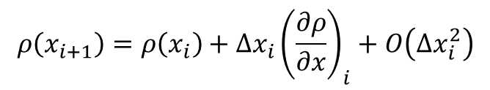
Taylor series expansion

Slide 8
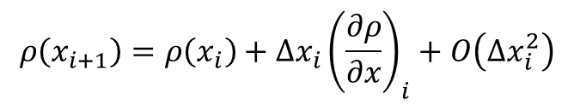
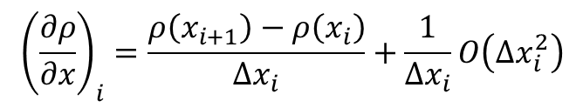
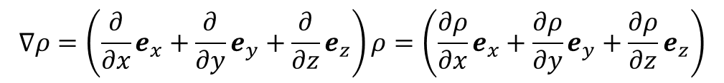
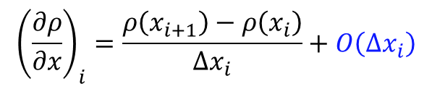
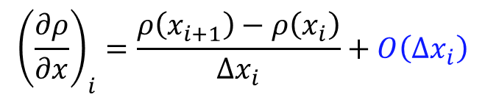
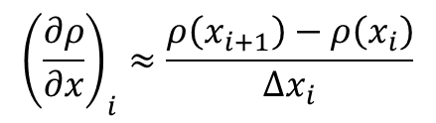
Taylor series and FDM
Taylor series:
Finite difference
First order derivative – forward difference method

Slide 9
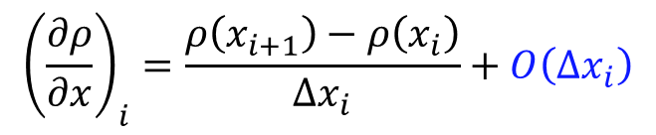
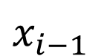
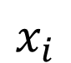
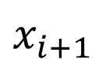
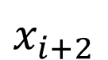
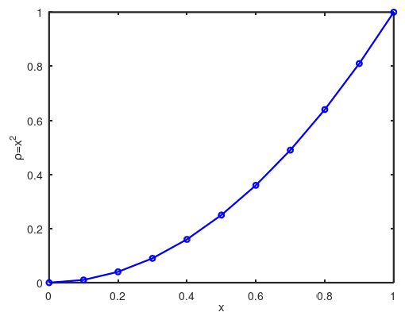
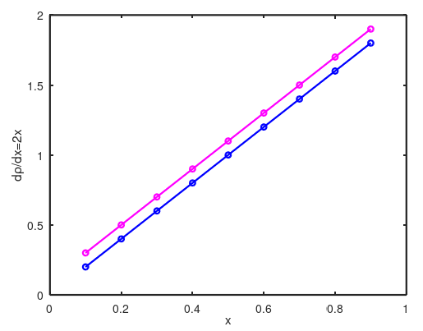
Analytical and Numerical solutions
Numerical result
Resolved in OCTAVE
Analytical result
Result of first order derivative of first order forward difference method

Slide 10
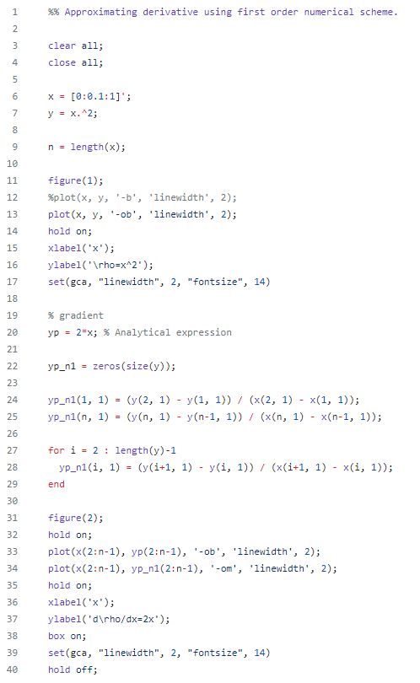
Analytical and Numerical solutions
Exercise – 2
OCTAVE
Analytical | Numerical
An analytical solution involves framing the problem in a well-understood form and calculating the exact solution. | A numerical solution means making guesses at the solution and testing whether the problem is solved well enough to stop.
Numerical result
Analytical result

Slide 11
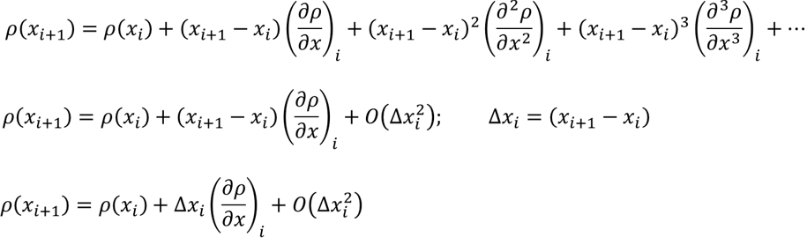
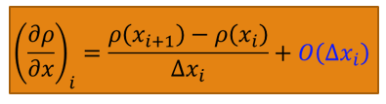
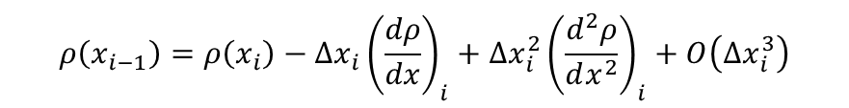
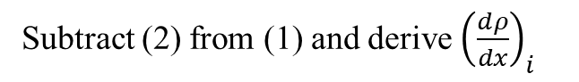
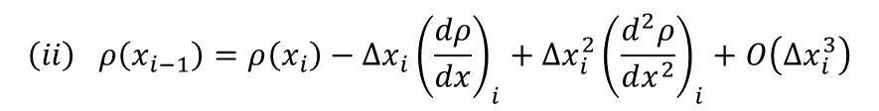
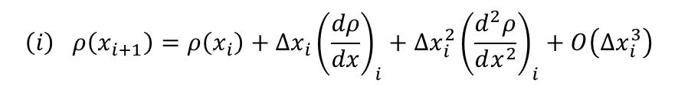
Exercise – 2 ➔ Octave
Derive first order derivative for: forward, backward, and central difference schemes. (Use Pen and paper)
Hint: derivation of first order forward difference
Hint: derivation of first order central difference
$$\left(i\right) ρ\left(x_{i+1}\right)=ρ\left(x_{i}\right)+Δx_{i}{\left(\frac{dρ}{dx}\right)}_{i}+Δx_{i}^{2}{\left(\frac{d^{2}ρ}{dx^{2}}\right)}_{i}+O\left(Δx_{i}^{3}\right)$$
$$\left(ii\right) ρ\left(x_{i−1}\right)=ρ\left(x_{i}\right)−Δx_{i}{\left(\frac{dρ}{dx}\right)}_{i}+Δx_{i}^{2}{\left(\frac{d^{2}ρ}{dx^{2}}\right)}_{i}+O\left(Δx_{i}^{3}\right)$$
Subtract (2) from (1) and derive ${\left(\frac{dρ}{dx}\right)}_{i}$
Hint: derivation of first order backward difference
$$ρ\left(x_{i−1}\right)=ρ\left(x_{i}\right)−Δx_{i}{\left(\frac{dρ}{dx}\right)}_{i}+Δx_{i}^{2}{\left(\frac{d^{2}ρ}{dx^{2}}\right)}_{i}+O\left(Δx_{i}^{3}\right)$$

Slide 12
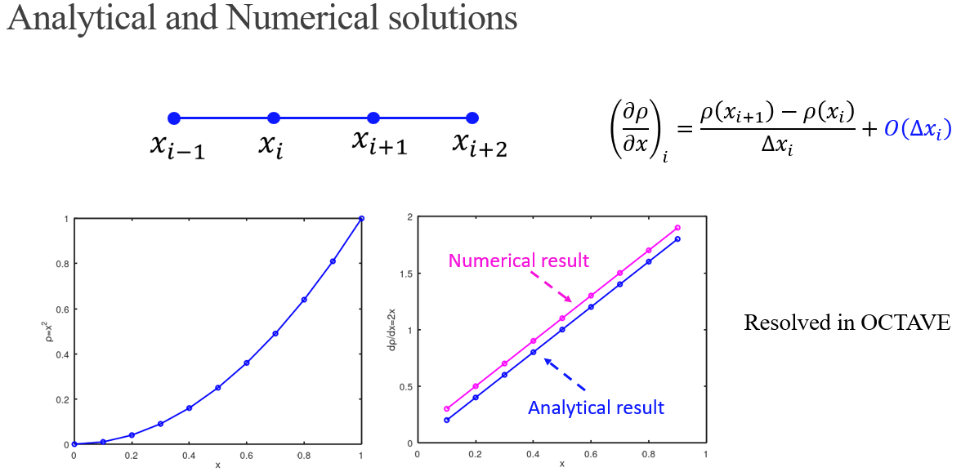
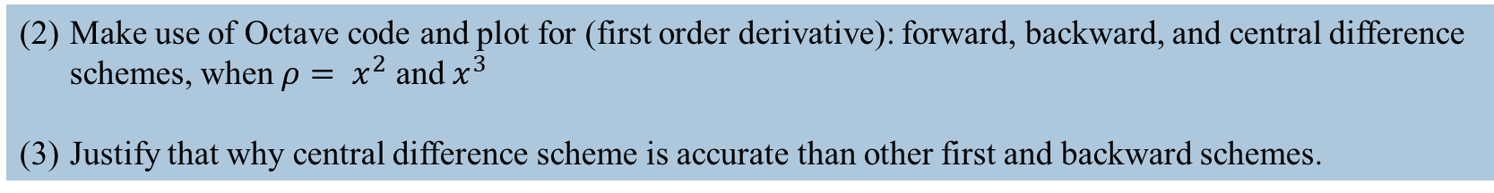
Exercise – 2 ➔ Octave
Make use of Octave code and plot for (first order derivative): forward, backward, and central difference schemes, when $ρ= x^{2}$ and $x^{3}$
Justify that why central difference scheme is accurate than other first and backward schemes.
Result of first order derivative of first order forward difference method

Slide 13
